Slide 1
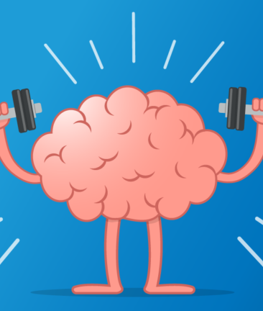

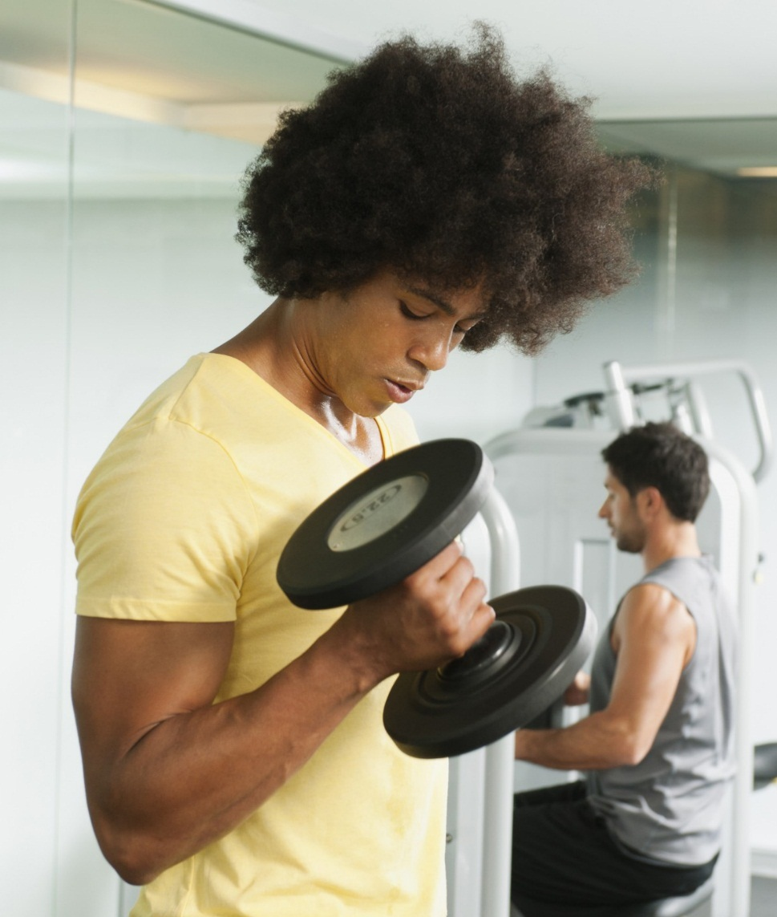
PHYSICAL AND MENTAL HEALTH
Balance BTW BOTH MATTERS…….
By :Team Amazing Us.

Slide 2
Problem discovered:
As per our survey we discovered that people are very moody and there is no motivation for them to work out
And with their busy schedule they often forget to look after their mental and physical health
And most of the people like to workout at their home
People are most likely to do other activities like dancing, cycling and swimming rather than going to gym and working with weight lifting exercises
People don’t prefer pre designed workout plans
Rather than gaining /losing weight people want to improve their flexibility

Slide 3
Our solutions to overcome problems:
We have developed our app as keeping both Mental & Physical health as concerns
When coming to the Mental health ,we have added certain features like mental health awareness videos and motivational thoughts as notifications to boost up people’s mood and to motivate them with a least way possible
And to look after their Mental health we have a unique feature to book slots with psychiatrists both online and offline
For people wanted to work out from their home & don’t like pre designed workout plans, we have Activity zone in physical health part to do their favourite activities too
Our app has Diet plan feature for people where they can customize their own diet plan as per their requirements

Slide 4
IMPORTANT
Both mental and physical health should be taken care of well from an individual to attain the term ‘FIT’/FITNESS
“As mental health problems significantly increase our risk of developing physical health problems and vice versa”
Nearly one in three people with a long term physical health condition also has a mental health problem ,most often depression and anxiety

Slide 5
MENTAL HEALTH PLAYS A MAJOR ROLE IN TERMS OF FITNESS OF AN INDIVIDUAL
Why is mental health a concern /important?
Mental health is very important and should be taken good care by every individual because
It helps to:
*Boost up one’s confidence
*Attain over all fitness ,to develop self care and self love
*Good mental health enables us to work more productively and reach our full potential
*A great sense of inner peace or calm
* Helps to determine how we handle stress, relate to others and make healthy choices

Slide 6
NOTE:IDEAS PRESENTED HERE IN THIS PPT CAN BE IMPLEMENTED BY us IN BOTH OF THEIR ONLINE AND OFFLINE SECTORS TOO..
…..

Slide 7
IMPLEMENTS WHICH CAN BE MADE THROUGH our MVP to help people to take care of their mental health:
Thoughts or positive quotes related to Confidence,Peace of mind, Self love, Self care, Self esteem and Happiness can be sent as notifications on home screen to consumers to their mobile phones to boost up their day and to refresh their mind.
IMPLEMENTATION :Single different thoughts 2-3 times a day.Likely /preferably at morning and night can be sent .
(It seems very less but trust me it does a lot to the person to kick start their day and to end their day with positiveness and peace)
Online Counselling sessions with experienced psychiatrists once in two or three weeks through video or audio call (if needed for users/consumers) as it helps people to solve their own emotional,social,personal or interpersonal problems which can be very helpful to come out from the traumas and problems and to have a peaceful and healthy mind.

Slide 8
Here are some positive and heart warming quotes:
Make every workout count
Do it because they said you can’t
Mindset is everything
Be you, Do you, For you
Don’t stop until you are proud
Be strong than your excuses
Things will Workout
Life is like riding a bicycle To keep your balance,You must keep moving
Good things take time
And many more…….

Slide 9
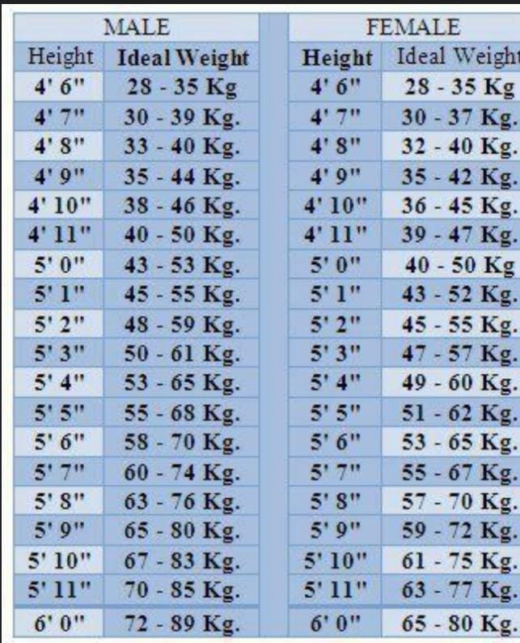
PHYSICAL HEALTH IMPLEMENTATIONS TO BE DONE:
The app should intake data from the customers or consumers like,
Their ,
age:
height:
weight:
requirement: (whether the customer wants to gain weight/loose weight/become fit)
BMI(BODY MASS INDEX) could be coded as shown in the fig to help
People to attain fitness by coding team

Slide 10
CUSTOMIZED DIET /FOOD PLAN [customized wrt customers taste and choice *Like in terms of veg and non veg A person can gain or lose weight by intaking only veg or by both veg & nonveg food ,As sufficient amounts of nutrients ,proteins, fats ,fibers and carbs are available in both the varieties too
VEGETARIANS
Providing customized food recipes like
Fruits: Intaking the data (their desired fruits which they like to eat )and providing proper diet plan recipes wrt their fitness choice by keeping in mind the nutrient and health benefit the fruit holds(coding team )
NON-VEGETARIANS
Different Egg recipes
Non veg soups

Slide 11
Veggies : Intaking the data (their desired vegetables which they like to eat )and providing proper diet plan recipes wrt their fitness choice by keeping in mind the nutrient and health benefit the vegetable holds(coding team )
SMOOTHIES AND MILK SHAKES TOO can be customized
Chicken or mutton recipes
All the above should be planned well in terms of weight and calories they hold wrt to persons wants
Dry fruits plays a major role in both veg and nonveg consumers to improve their health and fittness

Slide 12
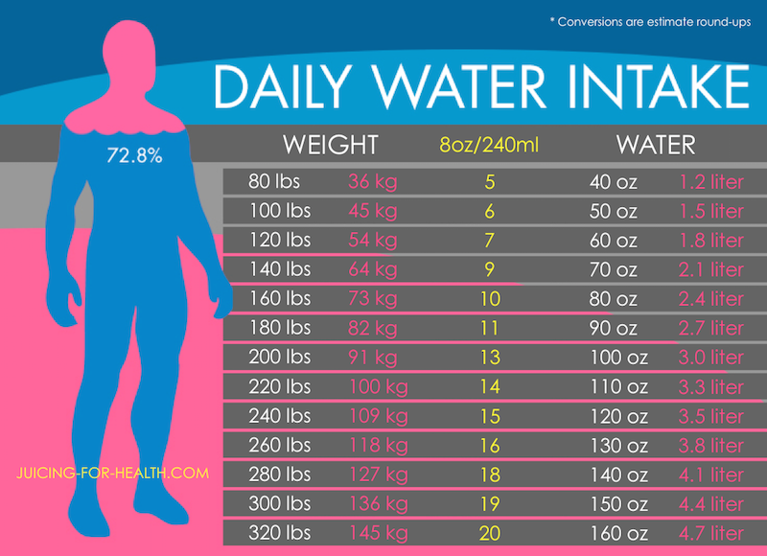
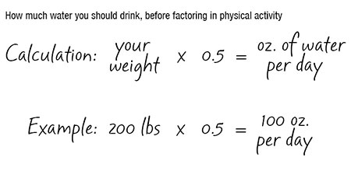
WATER INTAKE
To set reminders through notification to intake certain amount of water every now and then based on persons weight and height which finally helps to reach the targeted water intake
Coding team plays a vital role in customizing these things

Slide 13

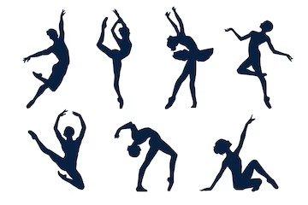
DANCE –WHICH IS MUST.
Dance helps to reduce stress, increases levels of feel good hormone serotonin and helps develop new neural connections and also refreshes a person’s mood ,body and soul
And we are designing the prototype to include other activities too
So I think there should be dancing sessions before or after the workout for atleast15-20 mins
Step 3 Title
Step 2 Title
Step 1 Title

Slide 14
So these are some of my own ideas in this short period of time .
Hope you liked our
ideas and thoughts and thank you for your valuable time and providing us with this opportunity…

Slide 15
Note
Our prototype will provide a detailed view of the app we are planning ,Please do check out our prototype submission.

Slide 16
THANKING YOU….
With regards,
Team :Amazing_us

